Slide 1

Deep Learning Based Object Detection For Autonomous Drones
by
U. Varun
Roll No. 204G1A05C0
M. Uma
Roll No. 204G1A05B5
P. Srinath
Roll No. 214G5A0511
A. Srinivasa Sree Sharan
Roll No. 204G1A05A3
Under the guidance of
Mrs. G. Nagaleela M.Tech.
Assistant Professor
Department of Computer Science and Engineering
Srinivasa Ramanujan Institute of Technology
(Autonomous)
2023 - 2024
B-18
DEPT. OF COMPUTER SCIENCE AND ENGINEERING
SRINIVASA RAMANUJAN INSTITUTE OF TECHNOLOGY
1

Slide 2

Contents
Deep Learning Based Object Detection For Autonomous Drones
Review-0 Comments
Abstract
Problem statement
Objectives of Project
Literature survey for first objective
Objective-1(Design & Implementation)
Literature survey for second objective
Objective-2 (Design & Implementation)
Proposed Work -(Methods to be followed for proposed system)
References
GitHub Link
Queries

Slide 3
Review-0 Comments
Deep Learning Based Object Detection For Autonomous Drones
Can you implement with drone?

Slide 4
Review-1 Comments
Deep Learning Based Object Detection For Autonomous Drones
Clarity about camera pixel?
Try to implement by drone?
Explain in detail about code?

Slide 5
Abstract
Deep Learning Based Object Detection For Autonomous Drones
Object detection plays a vital role in enabling drones to perceive and interact intelligently with their surroundings. The process involves data collection, selecting appropriate deep learning architectures for accurate detection. In our proposed system, we explore the integration of advanced deep learning techniques into autonomous drones for object detection.
The trained models efficiently predict object presence in real-time imagery. The project aims to significantly improve the accuracy and reliability of object recognition, enabling drones to distinguish between different objects and navigate their environment with increased precision. The project's outcomes hold promising possibilities for enhancing drone applications in fields such as surveillance, search and rescue.

Slide 6
Problem Statement
Deep Learning Based Object Detection For Autonomous Drones
Drones need to quickly recognize objects to avoid obstacles and make timely decisions.
Drones have restricted computing power, requiring efficient object detection models.
Objects appear differently under changing light and weather conditions, posing a challenge for accurate detection
The system should handle rare objects effectively, not just common ones.
Accurate object detection is essential for drones to safely navigate and interact with the environment.

Slide 7
Objectives of Project
Deep Learning Based Object Detection For Autonomous Drones
Develop a deep learning model that can accurately identify and classify various objects in real-time images captured by autonomous drones, enabling safer navigation.
To ensure that the object detection model runs efficiently on the limited computational resources of drones, enabling rapid decision-making and responsive actions in dynamic environments.

Slide 8
Literature Survey for First Objective
Deep Learning Based Object Detection For Autonomous Drones
[1] Real-time object detection is crucial for many applications of Unmanned Aerial Vehicles (UAVs) such as reconnaissance and surveillance, search-and-rescue, and infrastructure inspection. In the last few years, Convolutional Neural Networks (CNNs) have emerged as a powerful class of models for recognizing image content.
Object detection based on CNNs is extremely computationally demanding, typically requiring high-end Graphics Processing Units (GPUs) that require too much power and weight, especially for a lightweight and low-cost drone . In this paper , they used Regions with CNNs (R-CNNs), a state-of-the-art algorithm, to detect not one or two but hundreds of object types in near real-time.

Slide 9
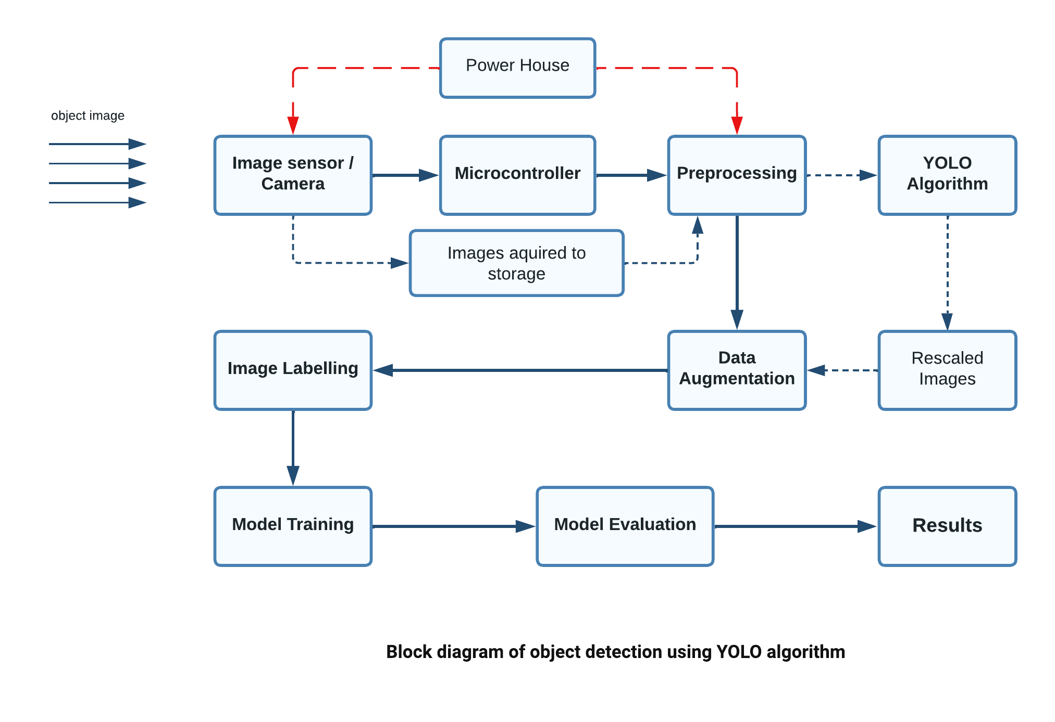
Objective-1(Design & Implementation)
Deep Learning Based Object Detection For Autonomous Drones

Slide 10

Objective-1(Design & Implementation)
Deep Learning Based Object Detection For Autonomous Drones

Slide 11

Objective-1(Design & Implementation)
Deep Learning Based Object Detection For Autonomous Drones

Slide 12

Objective-1(Design & Implementation)
Deep Learning Based Object Detection For Autonomous Drones

Slide 13
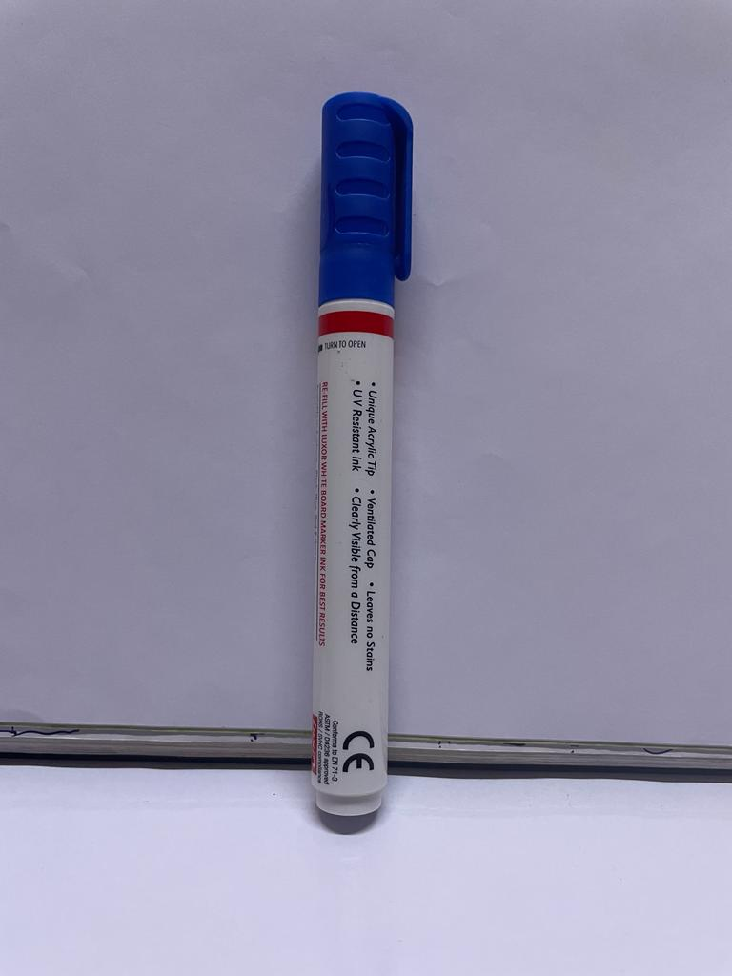

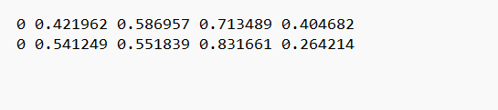
Objective-1(Design & Implementation)
Deep Learning Based Object Detection For Autonomous Drones

Slide 14
Literature Survey for Second Objective
Deep Learning Based Object Detection For Autonomous Drones
[2] Unmanned aerial vehicle (UAV) has recently become a hotspot across the fields of computer vision (CV) and remote sensing (RS). Inspired by recent success of deep learning (DL), many advanced object detection and tracking approaches have been widely applied to various UAV-related tasks, such as environmental monitoring, precision agriculture, traffic management.
[3] Deep learning-based object detection solutions emerged from computer vision has captivated full attention in re-cent years. The primary objective of the paper is to provide a comprehensive review of the state of the art deep learning based object detection algorithms and analyze recent contributions of these algorithms to low altitude UAV datasets.

Slide 15
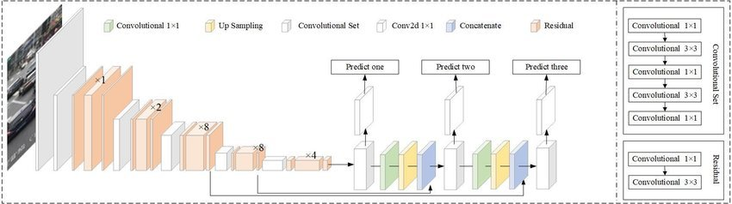
Objective-2(Design & Implementation)
Deep Learning Based Object Detection For Autonomous Drones

Slide 16


Objective-2(Design & Implementation)
Deep Learning Based Object Detection For Autonomous Drones

Slide 17
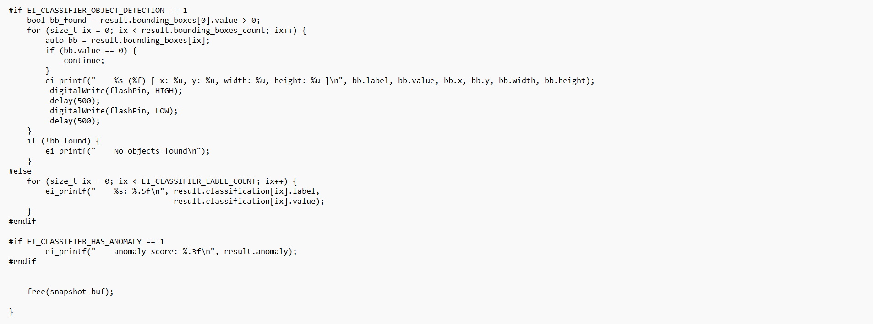
Objective-2(Design & Implementation)
Deep Learning Based Object Detection For Autonomous Drones

Slide 18
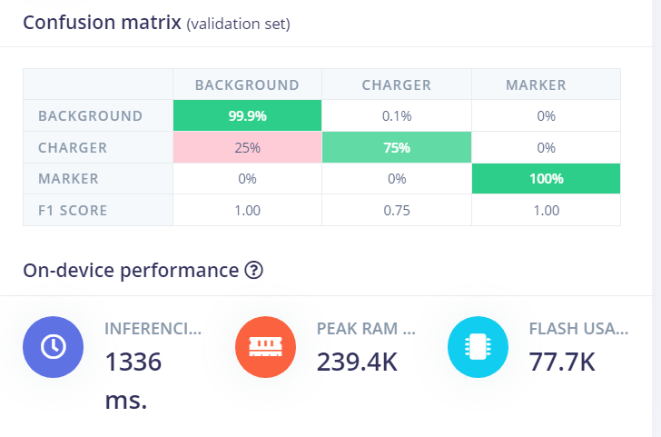
Objective-2(Design & Implementation)
Deep Learning Based Object Detection For Autonomous Drones

Slide 19
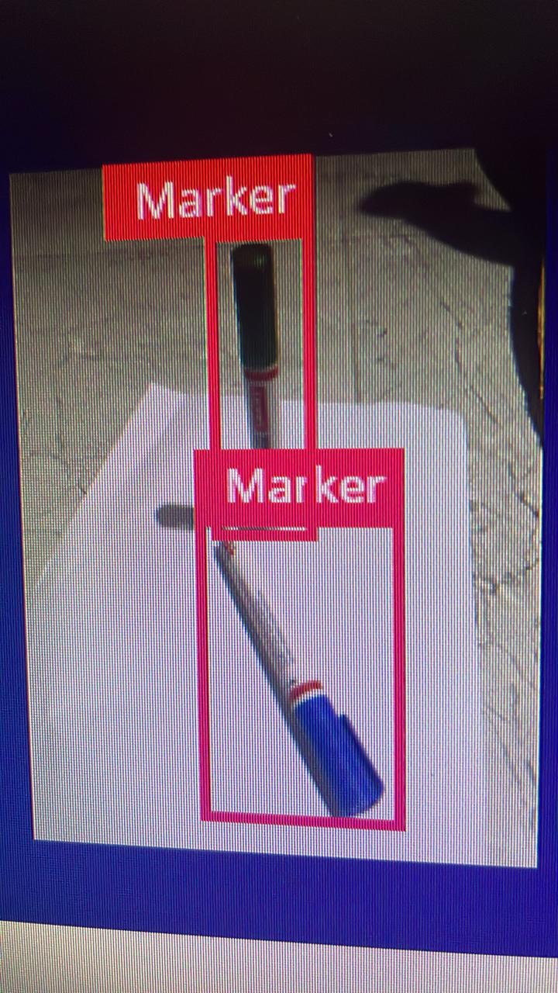
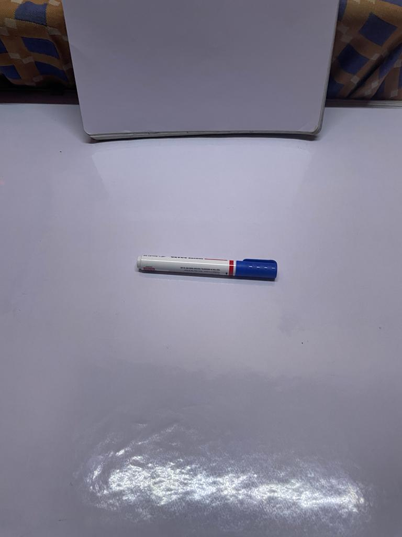
Objective-2(Design & Implementation)
Deep Learning Based Object Detection For Autonomous Drones

Slide 20
Proposed System
Deep Learning Based Object Detection For Autonomous Drones
Gather a diverse range of images showcasing various objects that drones need to detect. Annotate these images by marking the locations of objects.
Choose YOLO, a smart computer model known as a convolutional neural network (CNN). YOLO is designed to be fast and accurate in spotting objects in pictures.
Train the YOLO CNN by showing it lots of images containing different objects. Deploy the trained YOLO CNN onto the drone's computer system. Whenever the drone takes pictures, this model quickly analyzes those images to see if any objects are present.
Ensure the model can handle various scenarios. It should be able to identify objects accurately even when faced with challenges like different lighting conditions or objects appearing in unexpected ways.

Slide 21
References
Deep Learning Based Object Detection For Autonomous Drones
[1]. Jangwon Lee, Jingya Wang, David Crandall, Selma Sabanovi ˇ c, and Geoffrey Fox” Real-Time, Cloud-based Object Detection for Unmanned Aerial Vehicles”pp.8,2021.https://ieeexplore.ieee.org/document/7926512
[2]. Payal Mittal a , Raman Singh b , Akashdeep Sharma c, ⁎” Deep learning-based object detection in low-altitude UAV datasets: A survey”pp.1-13.https://deep_learning_based_object_detection_in.pdf
[3]. Xin Wu, Member, IEEE, Wei Li, Senior Member, IEEE, Danfeng Hong, Senior Member, IEEE, Ran Tao, Senior Member, IEEE, and Qian Du, Fellow, IEEE,” Deep Learning for UAV-based Object Detection and Tracking:ASurvey”pp.24,2021.https://arxiv.org/pdf/2110.12638

Slide 22

Git Hub Dashboards of Each Student
Deep Learning Based Object Detection For Autonomous Drones

Slide 23
Any Queries?

